Slide 1

KISHKINDA UNIVERSITY
Department of Computer Science & Engineering
Project Presentation on
“Team Travel Planning Tool”
Team members
1. T.G.Manikanta - Btech-CSE082
2. Rohit - KUB23CSE117
3. Bindu - KUB24CSE027
4. Yashvant - Btech-CSE088
5. Harish - KUB24CSE042
6.T.Raghavendra - KUB23CSE145

Slide 2
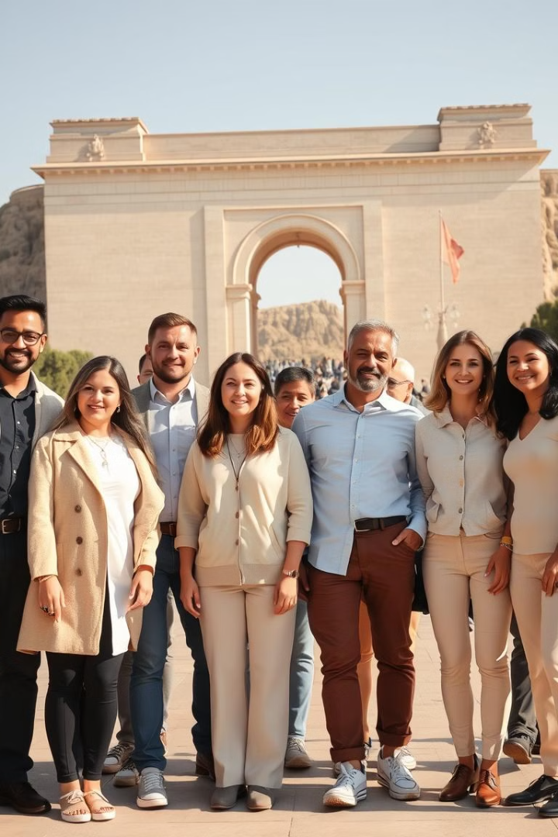
Team Travel Planning Tool
Streamline Team Travel Plans For A Memorable Experience.
Why this tool is helpful ?
Expense tracking: Helps companies manage their finances by ensuring employees follow the company's travel policy
Booking flights: It's best to book flights as soon as possible after setting departure and return dates
Sharing itineraries: Can help ensure everyone is kept up-to-date about trip details

Slide 3

Objective
Simplify the travel planning process for teams.
1
Reduce Stress
2
Increase Efficiency
Minimize planning hassles.
Automate tasks for faster execution.
3
Enhance Collaboration
4
Promote Team Bonding
Promote team involvement in the planning process.
Create a more enjoyable travel experience.

Slide 4
Existing System and Proposed System
Transition from manual to automated travel planning.
Existing System
Proposed System
Manual spreadsheets, emails, and phone calls.
Interactive platform with user-friendly interface.
Lack of centralized information.
Centralized repository for all travel details.
Inefficient communication.
Real-time communication and collaboration.

Slide 5
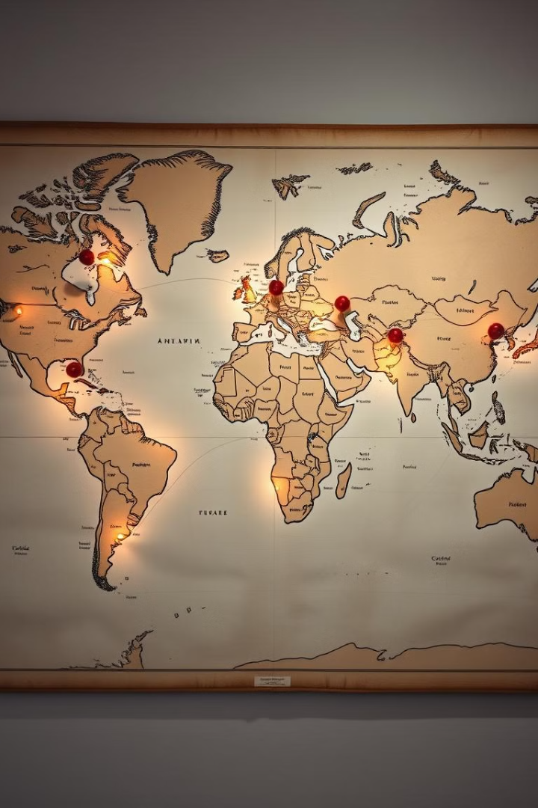
Vision and Mission
Empower teams to effortlessly plan and manage travel arrangements.
Vision
Mission
To become the leading travel planning tool for teams.
To simplify, automate, and enhance the team travel planning process.

Slide 6
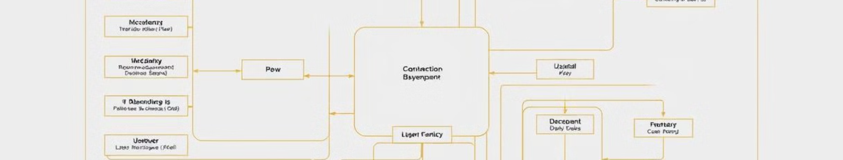
Requirements Specification
Detailed specifications guide development.
Functional Requirements
Booking flights, hotels, and car rentals.
Non-Functional Requirements
Security, reliability, and performance.
Software Requirements
Python 3.2, Vs Code, SQLite.
Hardware Requirements
Intel i5 processor, 500GB hard disk, 8GB RAM.

Slide 7





Modules
A modular approach for organized development.
Itinerary Builder
Create and manage travel itineraries.
Budget Tracker
Track expenses and manage budgets.
Communication Tools
Facilitate team communication and collaboration.
User Interface
Intuitive and user-friendly interface.

Slide 8
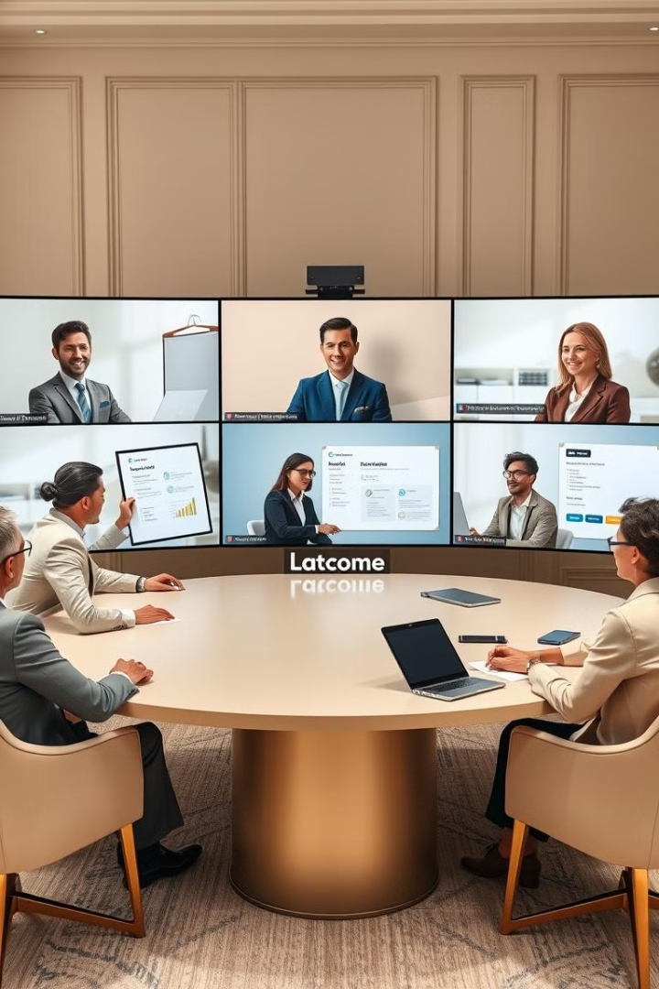




Team Communication and Coordination
Seamless communication and coordination.
Real-time Chat
Shared Calendar
Instant messaging for quick discussions.
Track travel dates and important events.
Alerts and Reminders
Document Sharing
Stay informed about key deadlines and updates.
Access and collaborate on travel documents.

Slide 9
Advantages and Disadvantages
Weighing the pros and cons for informed decision making.
Advantages
Disadvantages
Reduced travel planning stress.
Potential technical challenges.
Increased team efficiency.
Requires initial setup and training.
Improved collaboration and communication.
May not be suitable for all teams.

Slide 10

Conclusion
A valuable tool for streamlining team travel.

Slide 11
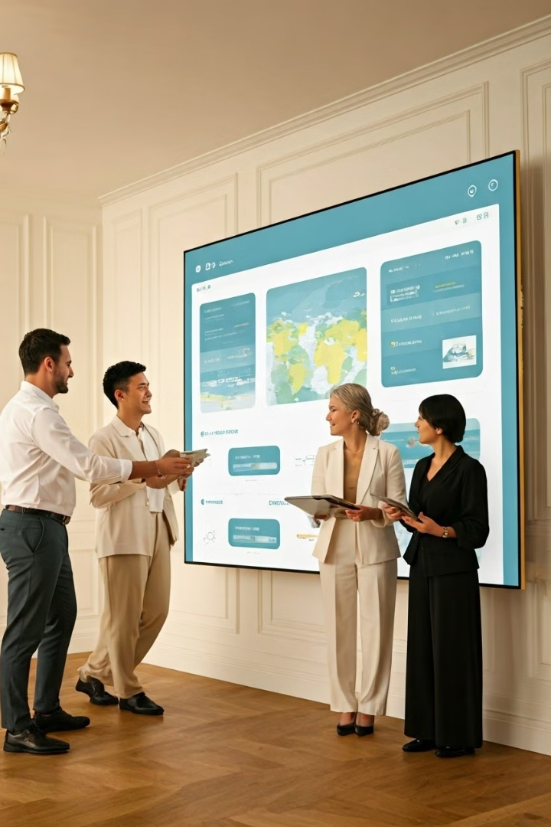
Future Enhancements
When thinking about future enhancements for a team travel planning tool, the goal is to streamline coordination, improve user experience, and provide valuable insights. Here are some potential enhancements:
AI-Powered Travel Recommendations
⁠Real-Time Collaboration & Coordination
Automated Expense Tracking & Management
⁠Enhanced Communication Tools
⁠Sustainability & Carbon Footprint Tracking

Slide 12
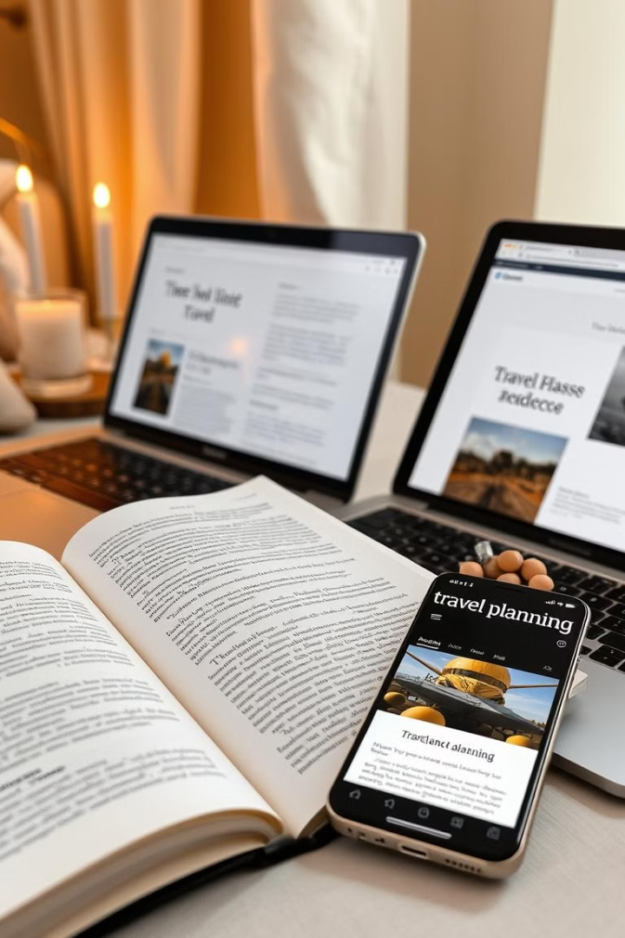
References
Drawing upon various sources for guidance and inspiration.
Team Travel Planning Best Practices
Travel Industry Trends and Innovations
User Experience Design Principles

Slide 13


